Slide 1
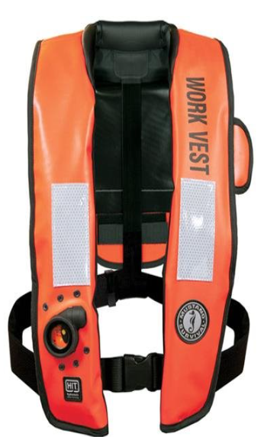
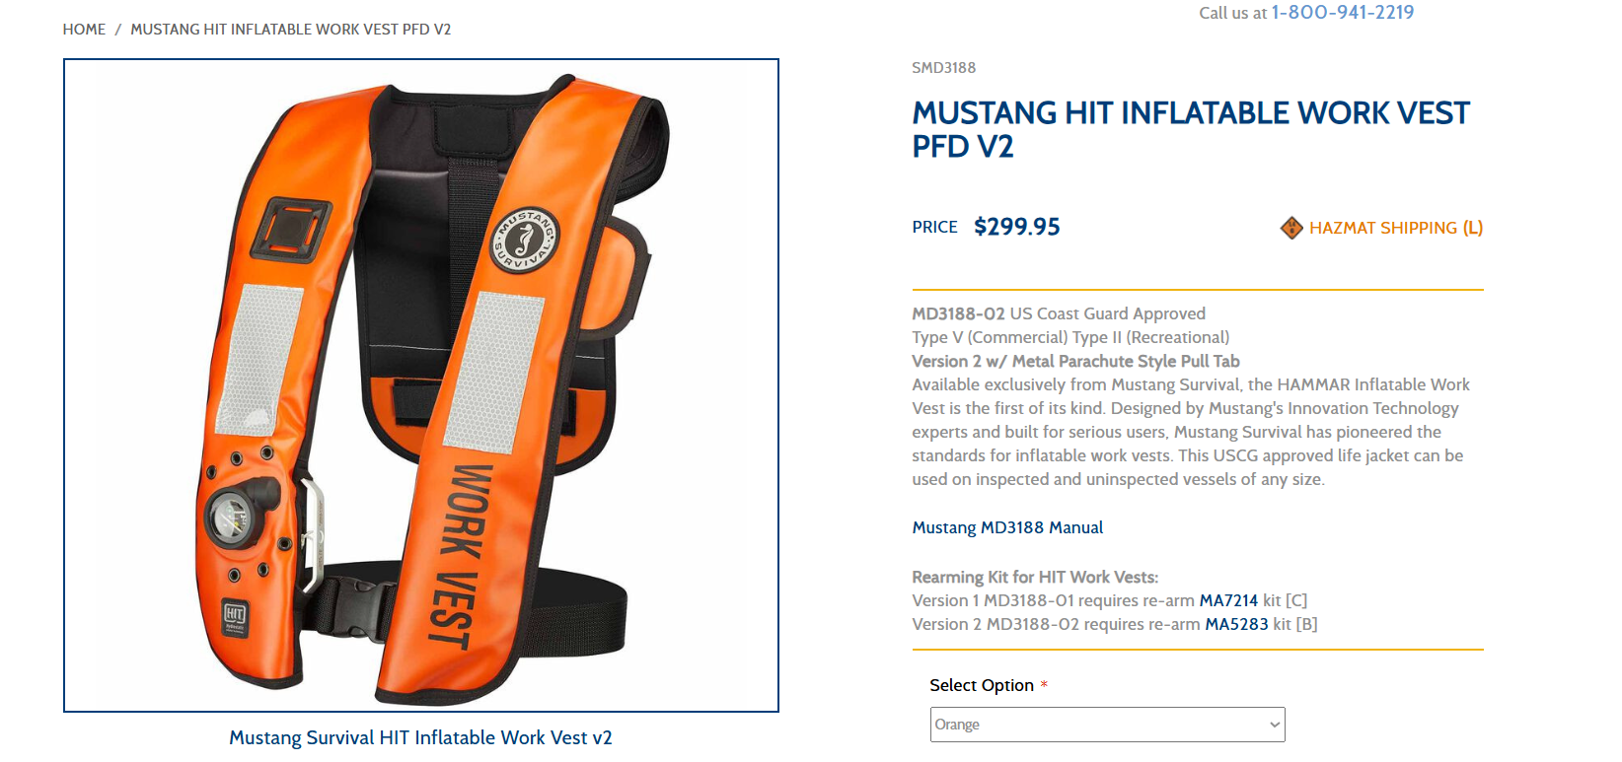
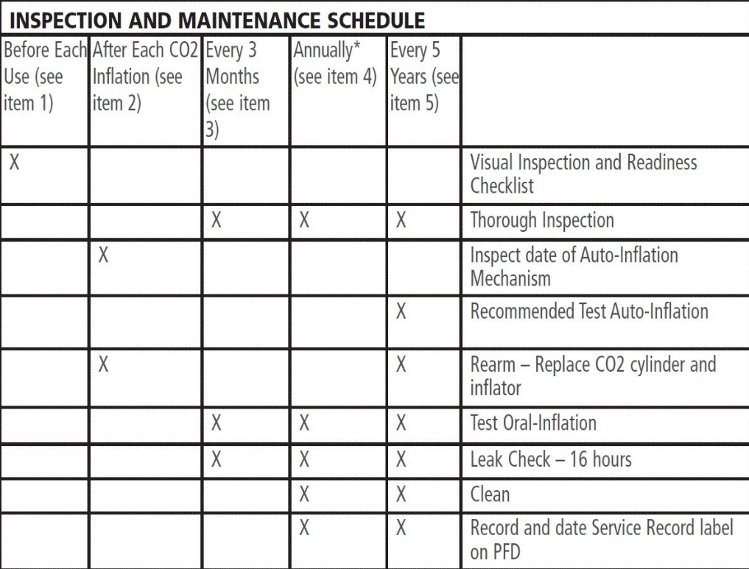
Early Learning Bulletin
Sphera No: 4907038 Location: Vito MC 939 Date: 3-7-2026
Upon reviewing safety practices for personnel working over water, it was determined that no formal preventive maintenance plan existed for the periodic inflation testing of life vests, aside from routine visual inspections. To close this gap, we consulted with other offshore Shell platforms and vessels to benchmark their processes and obtained an established maintenance protocol. Based on this guidance, we will implement a structured inspection and inflation‑testing program on a three‑month cycle to ensure all life vests remain fully functional, reliable, and compliant with applicable safety standards. Approximately 5 out of 15 TYPE 5 life preservers failed to meet the manufacturer requirement for the inflatable test. They were removed from service.
Preliminary Learning Points
> Life jacket visual inspections were being preformed prior to over-water work activity but not testing the integrity of the inflatable portion according to manufacturers specifications.
> Gaps were identified with current inspection and maintenance plan for all TYPE 5 Inflatable Life preservers.
Discussion
> Are inflatable TYPE 5 life preservers being tested at your location according to manufacturers requirements and intervals?
Recommendations
> Implement Quarterly PM to meet manufacturers recommended inflation testing requirement
> Replacement on a minimum 5-year interval or when inspection criteria is not met.
Tape
This Learning Bulletin provides preliminary learnings. For internal use only.

